Slide 1
Using NLP to Explore ‘Love’ In TED Talks By Sean Davern
Notes:
Good morning everyone! I'm Sean Davern and I've come to talk to you about love. As you know love is a complex word with many meanings and ways of expressing. I thought it would be interesting to see how TED talk authors talked about and expressed their passions. So today I'd like to show you some work I've done to apply natural language processing of TED talks to explore love.

Slide 2
Source Data
TED
kaggle
Filter, Clean
Tokenize
Corpus
Transcripts
Contain love+
Sentences with love+
2550
1132
1132 ‘Documents’
3160 Sentences
Notes:
Rounak Banik, Talks on TED.com thru Sept 2017
At this point, over half the documents contain a single sentence.
The rest have somewhere between 2 and 50 sentences that contain love in them.

Slide 3
NLP Methods Used
Corpus
Evaluate
Clusters
CV, Binary
Normalize
Vectorize
Reduce Dimensions
Cluster
CountVectorizer
TfidfVectorizer
LSA: 2-6
Topics
K-Means, DBScan,
MeanShift
Hierarchical, Spectral
Notes:
Tfidf = Term Frequency – inverse document frequency
LSA = Latent Semantic Analysis
DBSCAN = Density Based Spacial Clustering of Applications and Noise
Hierarchial = AgglomerativeClustering with Ward, Average, and Complete linkages

Slide 4
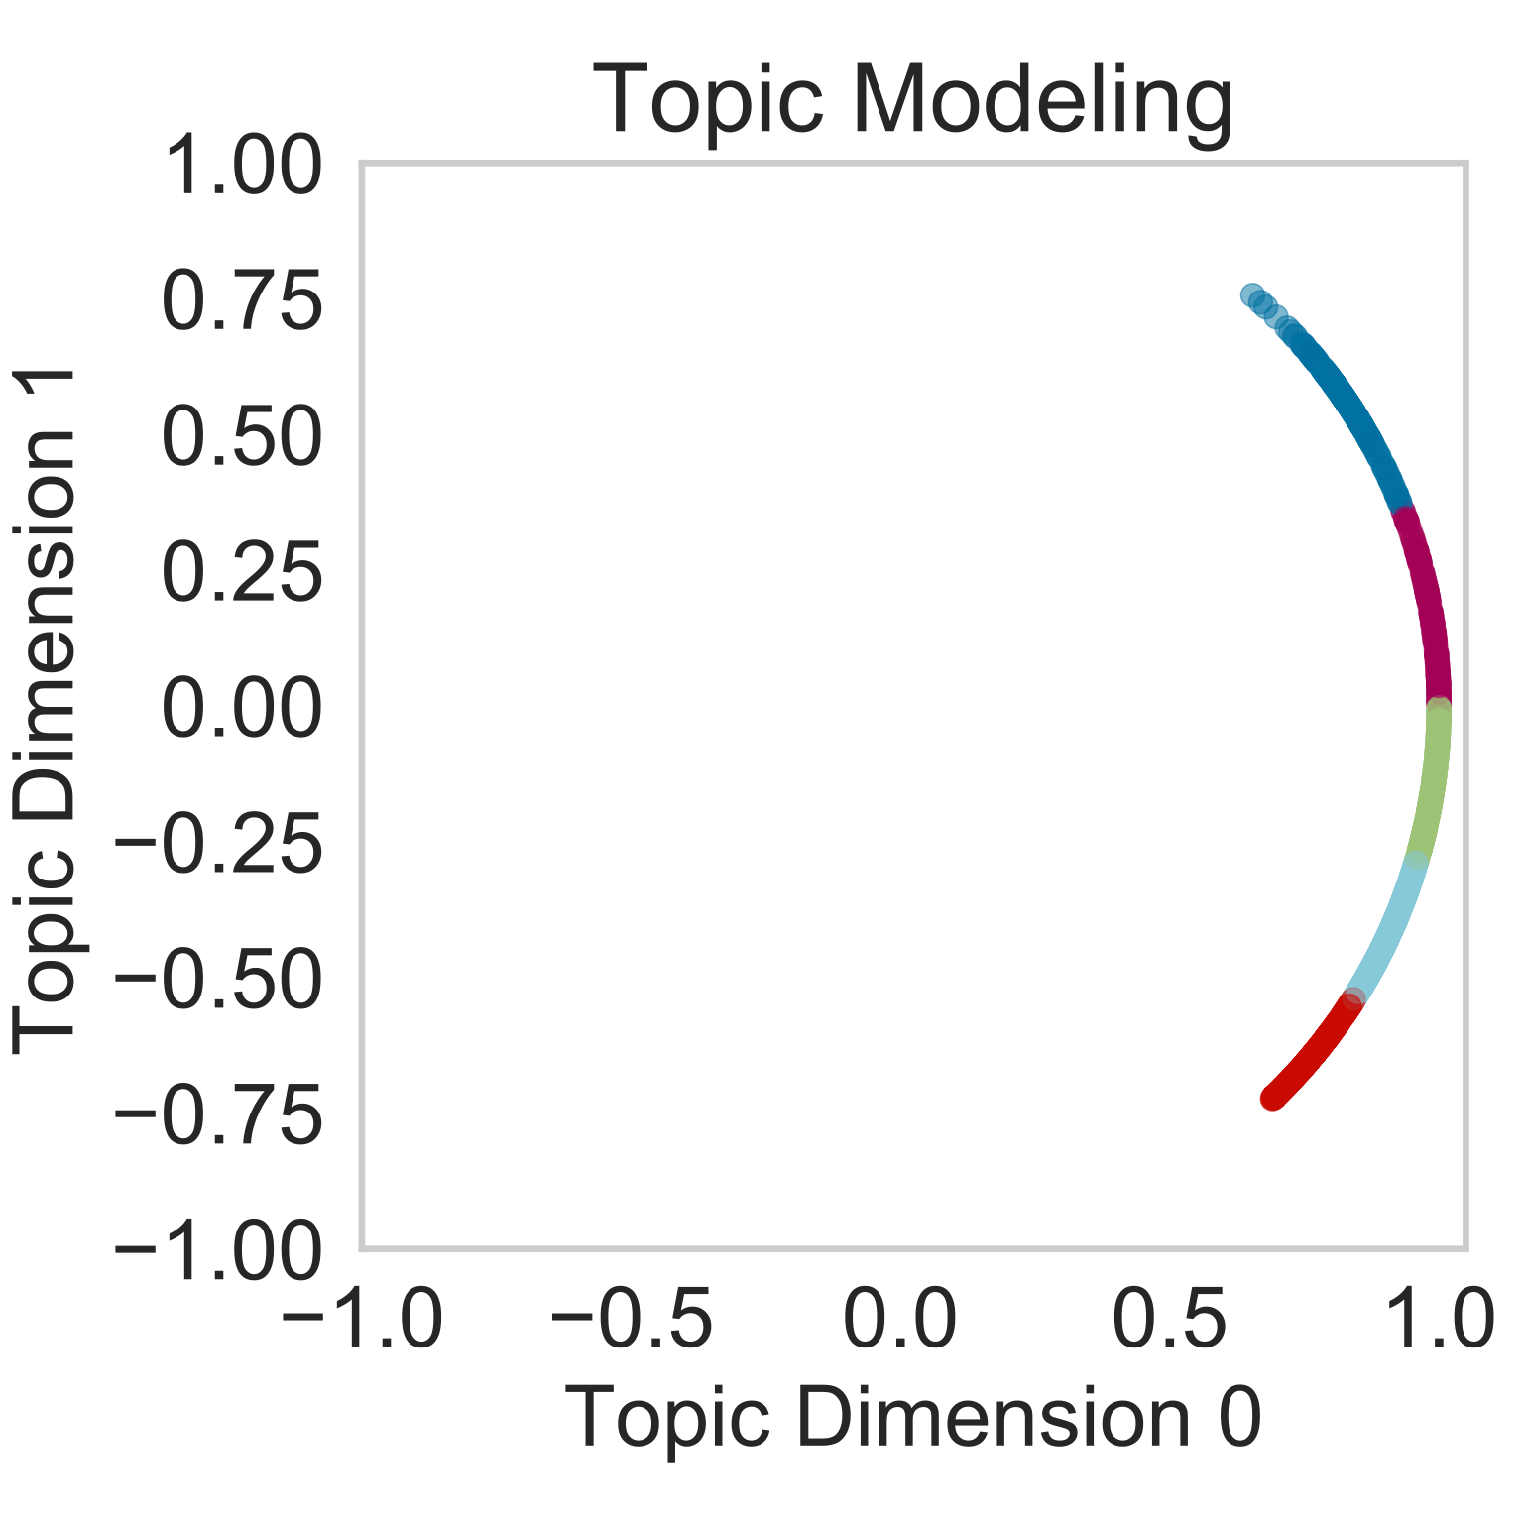
Normalize & Cluster
Normalizing (projecting onto the unit circle) covers a relatively small arc
Dimension 0 can effectively be neglected (visually)
Notes:
As you can see from the 2 topic dimensions case

Slide 5
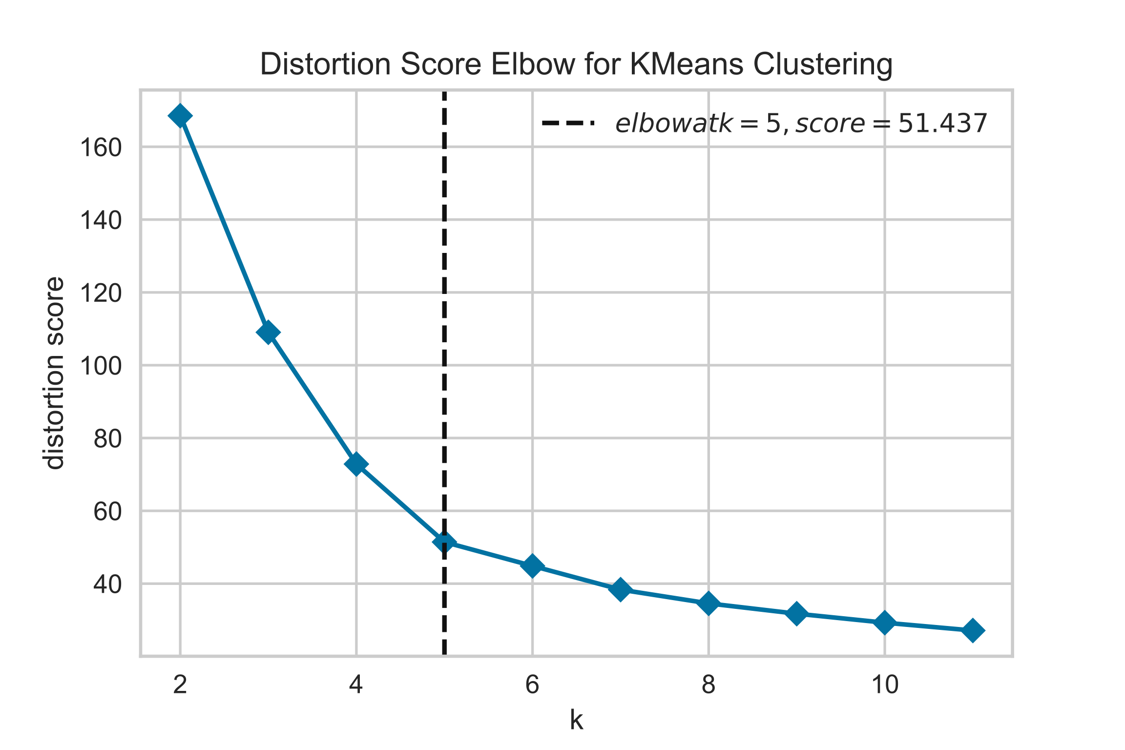
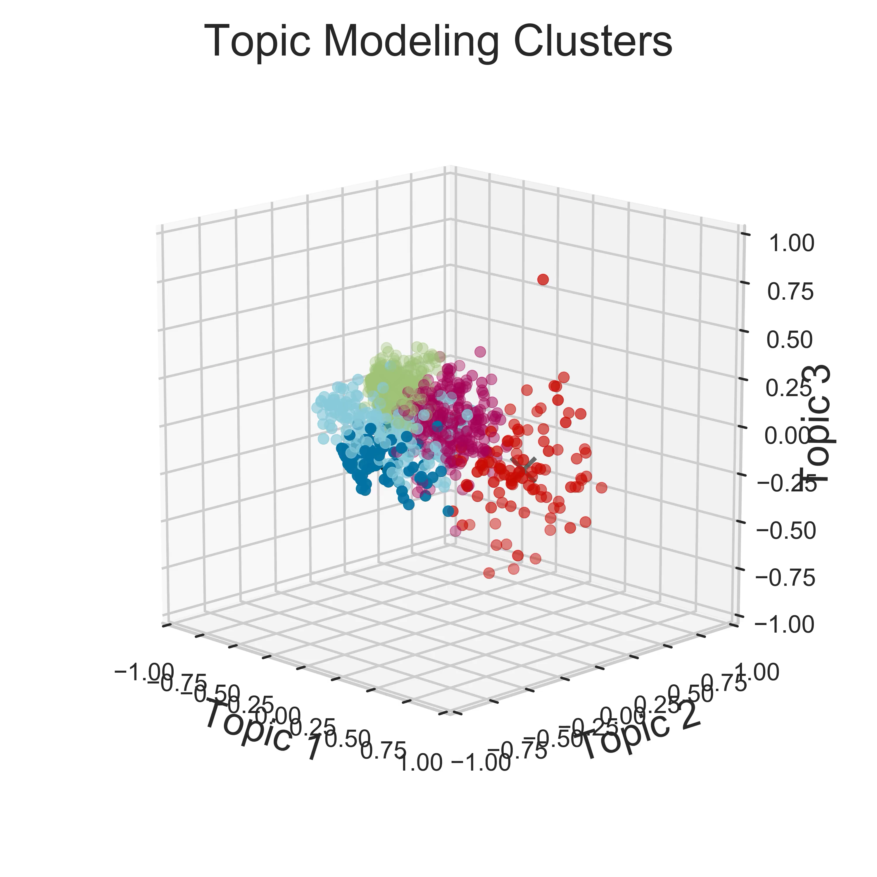
4-Topic Model
in love
I love
lover
I/we loved
loved ones
Notes:
(green): (obj) “in love”, “an expression of love”, I love (1/2)
(mag): (present tense feeling) I love, his real love, - I love you, a lot of love in these passwords – expect to find love (3-5)
(cyan): (past tense feeling) I/we loved (3+)
(blue): loved ones – loved it – loved the sound – we loved (1)
(red): (n., obj.) plant lover – gave them love, met the love of their life, all this love,– not my lover, music lovers, jazz lovers (5+)

Slide 6
Conclusions & Future Work
NLP was able to identify distinguishable clusters
These clusters weren’t particularly insightful regarding exploring how authors talked about love.
Tools to mathematically validate the distinguishability of clusters in higher dimensions would be helpful!

Slide 7
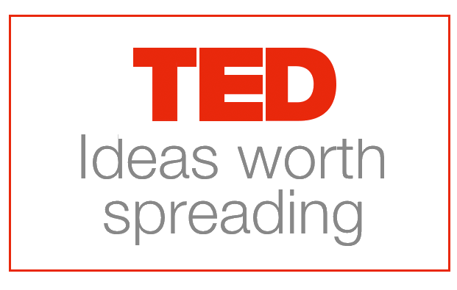
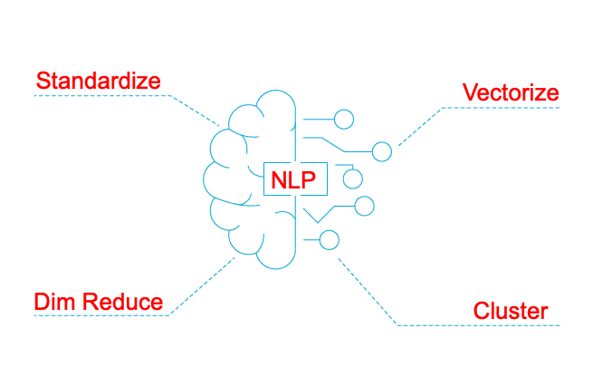
Questions?
+

Slide 8

Appendix

Slide 9
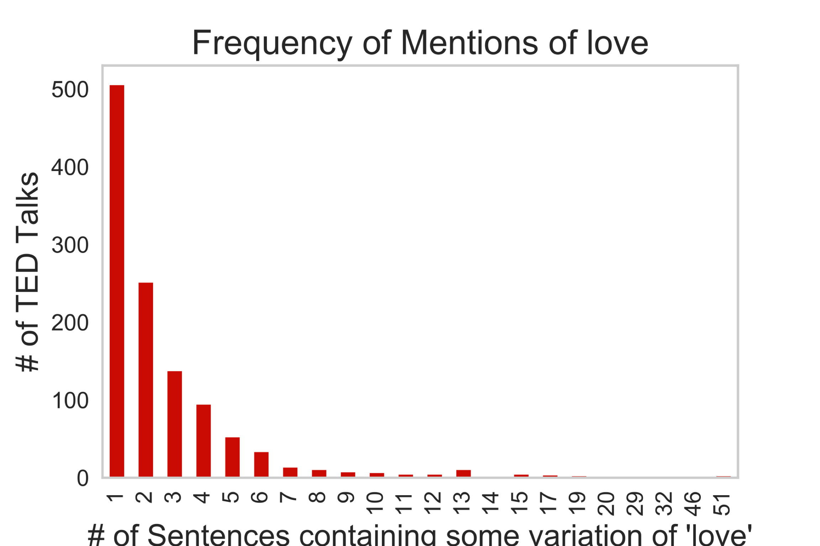
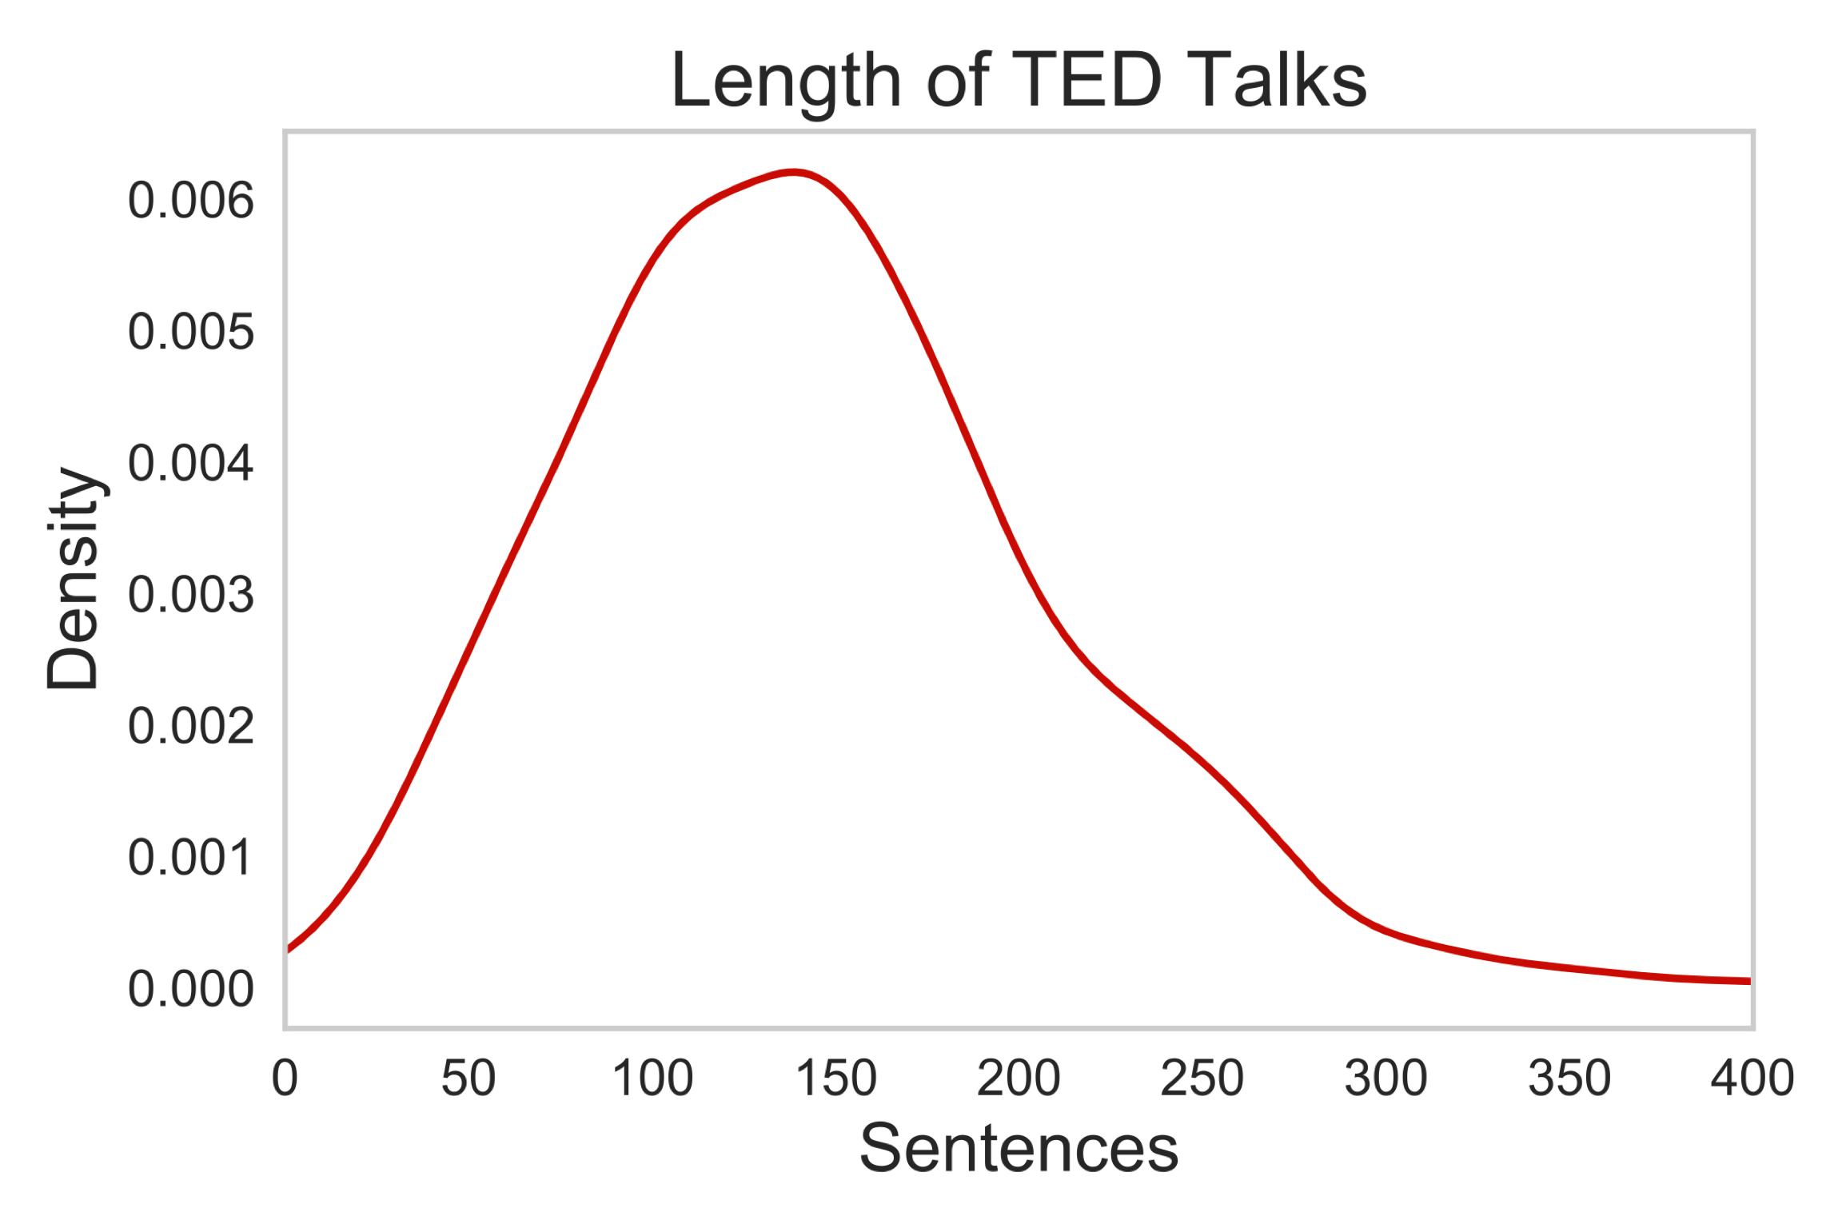
Love Content

Slide 10
Cluster Sense Making
(green): (obj) “in love”, “an expression of love”, I love (1/2)
(mag): (present tense feeling) I love, his real love, - I love you, a lot of love in these passwords – expect to find love (3-5)
(cyan): (past tense feeling) I/we loved (3+)
(blue): loved ones – loved it – loved the sound – we loved (1)
(red): (n., obj.) plant lover – gave them love, met the love of their life, all this love,– not my lover, music lovers, jazz lovers (5+)

